Slide 1

The Communication / Leadership Program Tailored For You

Slide 2
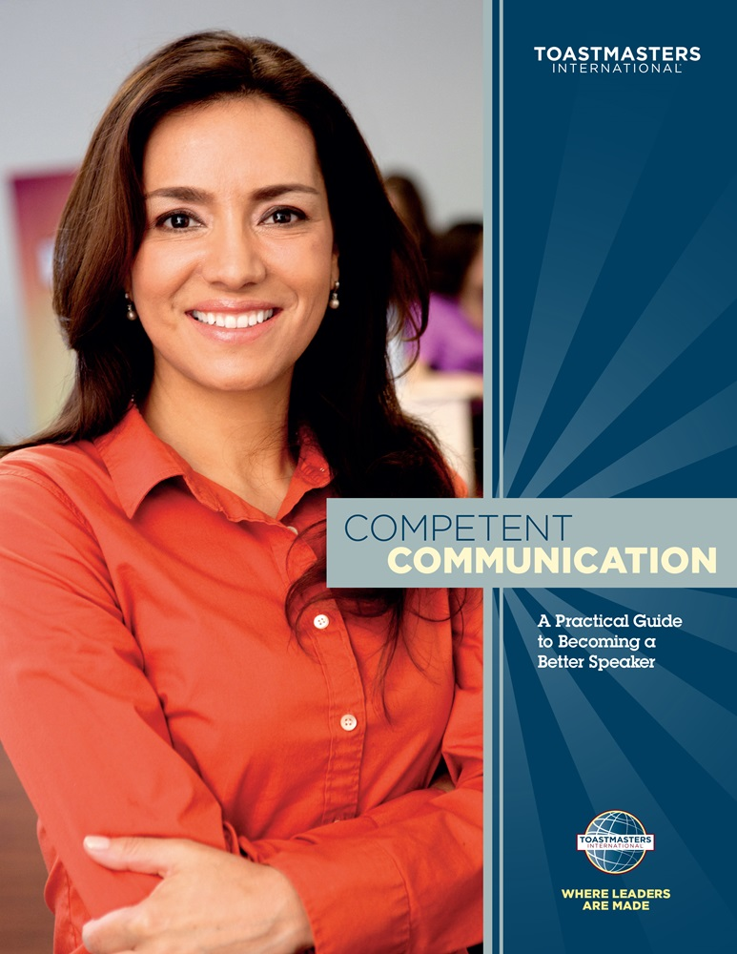
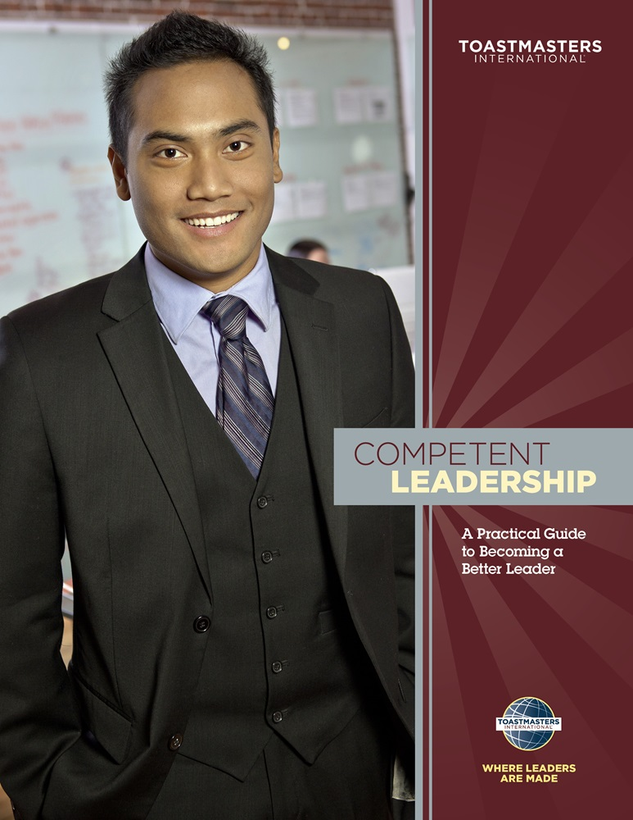
Get Comfortable to Engage the Audience
Speech organization
Body Language
Use of humor
Evaluation
Effective meetings

Slide 3
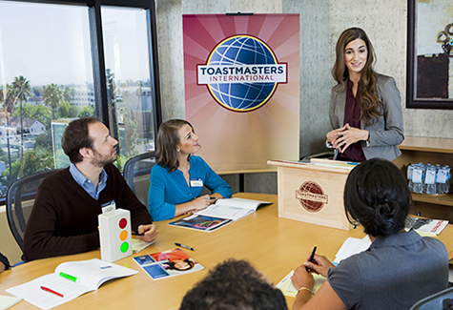
How Toastmasters Helps
Systematic, Self-paced Learn-by-doing
Weekly practice:
  Prepared or impromptu speeches
  Evaluation
  Leadership roles
No instructor

Slide 4
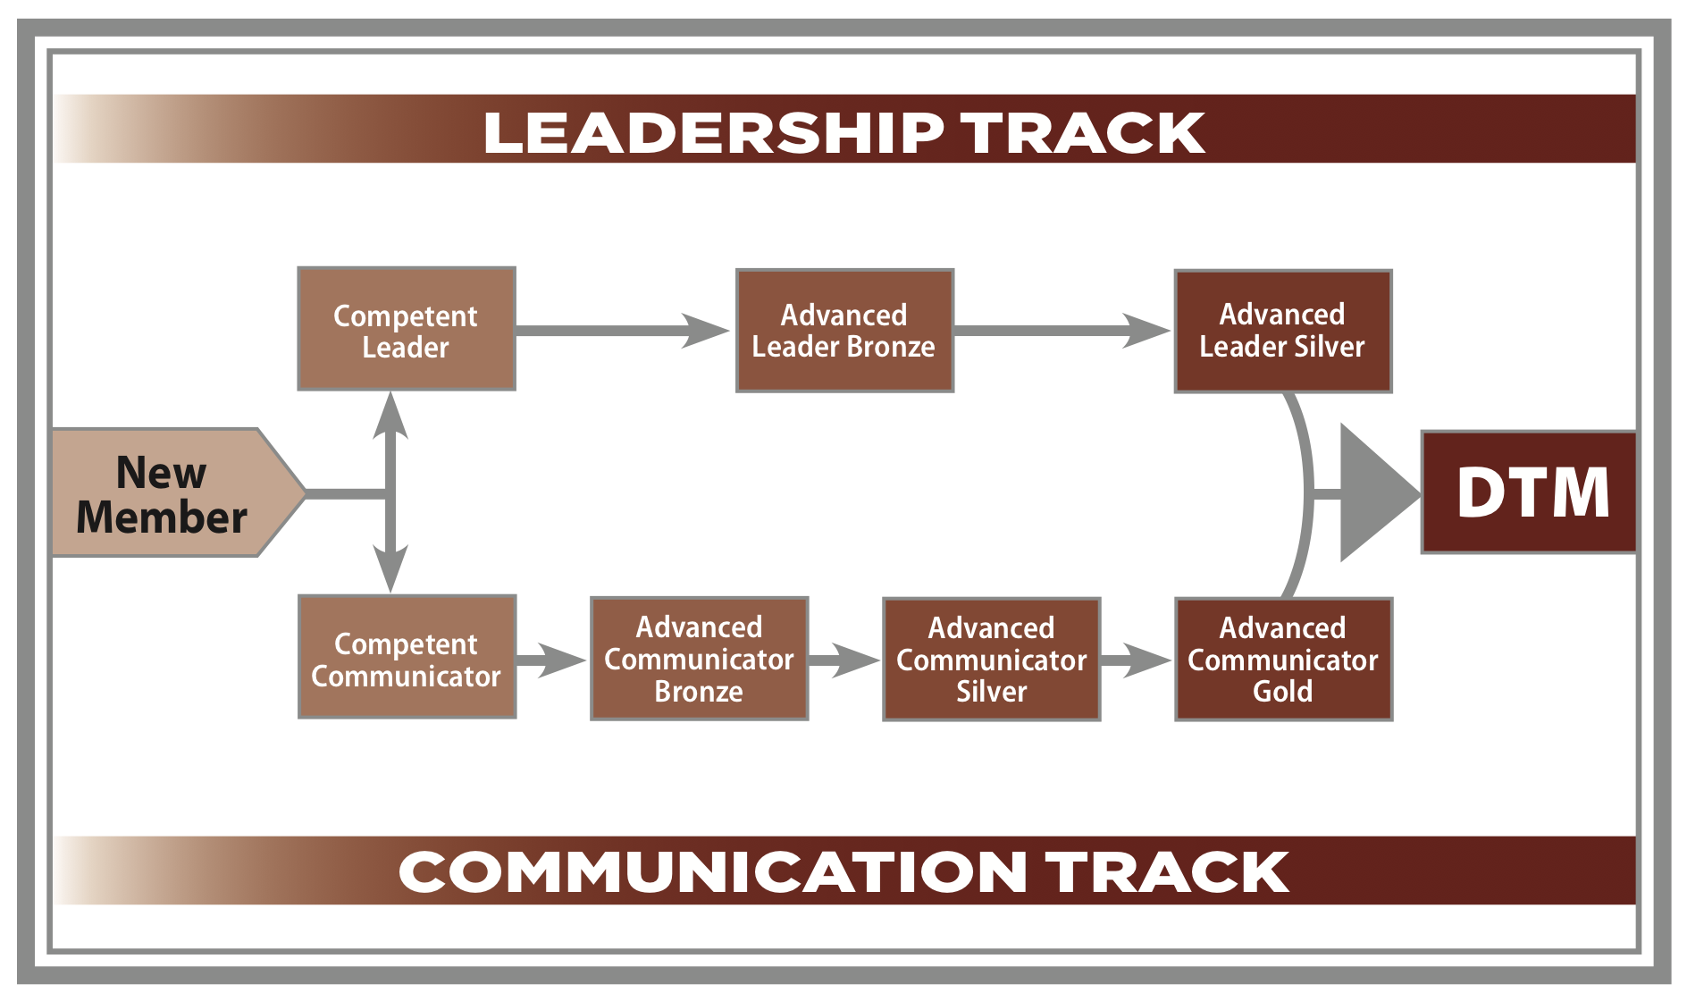
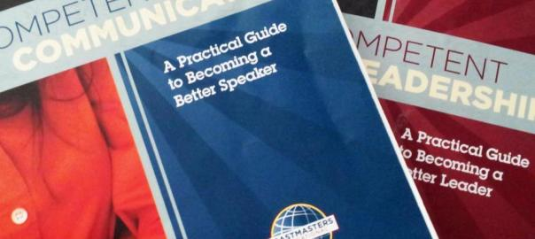

Educational System

Slide 5
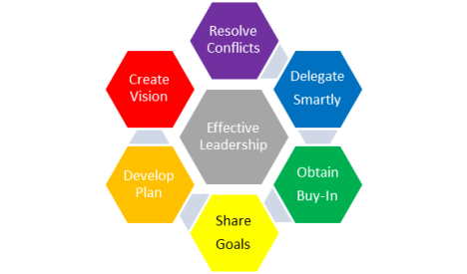

The Leadership Program

Slide 6
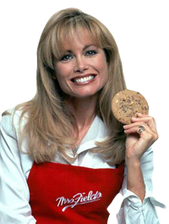
Find Your Voice
“The idea of getting in front of a group, not as Mrs. Fields but as Debbi, made my knees shake. But the Toastmasters group understood. Here’s a place where you can learn, grow, develop — and where other people are doing and feeling the same thing.”
Debbi Fields Rose
Founder, Mrs. Field’s Cookies

Slide 7
What’s Next?
Fulfill club meeting roles
Serve in officer roles at the club level and beyond
Launch the club with 20+ members and 7 club officers

Slide 8
Value

Slide 9
“Ours is the only organization I know
dedicated to the individual.”
– Dr. Ralph C. Smedley
Founder of Toastmasters International

Slide 10
Toastmasters Advantages
Practical presentation experience
A safe place to make mistakes
and learn
Mentorship opportunities

Slide 11
Features
A self-paced program
Weekly, bi-weekly or monthly interactive meetings
Impromptu speaking opportunities
Peer evaluations
Participation in leadership through meeting roles
Personal attention in small group setting
Affordable dues
Opportunities to lead meetings

Slide 12
Benefits
Develop critical-thinking skills
Build listening skills
Give and receive constructive feedback
Become more confident in front of a group
Learn time-management skills
Benefit from a supportive environment
Develop leadership skills

Slide 13
Individual Value
Unlimited personal growth
Clear communication skills
Self-confidence
Positive mentoring relationships
Improved leadership skills
Relationship building

Slide 14
Well-known Toastmasters Alumni
Chris Matthews, Author and journalist, host of MSNBC’s
Hardball with Chris Matthews
Tim Allen, Actor, star of television series Home Improvement
Tom Peters, Management expert and author
K.C. Jones, Former NBA basketball coach for Boston Celtics
Linda Lingle, Former governor of Hawaii
James Lovell, Former NASA astronaut; missions include Apollo 13
Debbi Fields Rose, Founder, Mrs. Fields Cookies
Leonard Nimoy, Actor, Spock from T.V. series Star Trek
Barbara Khozam, Speaker, Author, San Diego’s favorite AS

Slide 15
“Toastmasters is the best and least expensive personal improvement class you can go to.”
– Linda Lingle
Former governor of Hawaii

Slide 16
Costs
$21.60: New member fee (Once for a life time fee.)
$36: Six months’ membership dues
Note: check with the company to see what’s their finance plan

Slide 17
Why is Toastmasters for You?
Low-cost communication and leadership training
Practical experience
Confidence building
Networking
Constructive evaluations

Slide 18
Contact Information
<sponsor name> <sponsor email>
<mentor name> <mentor email>
<area director name> <area director email>
…

Slide 19
www.d5tm.org
www.toastmasters.org

