Slide 1
The Art of Evaluations
Henry Heller

Slide 2
Supportive
Positive
Enlightening
Considerate
Informative
Authentic
Logical

Slide 3
S
P
E
C
I
A
L
upportive
ositive
nlightening
onciderate
nformative
uthentic
ogical

Slide 4
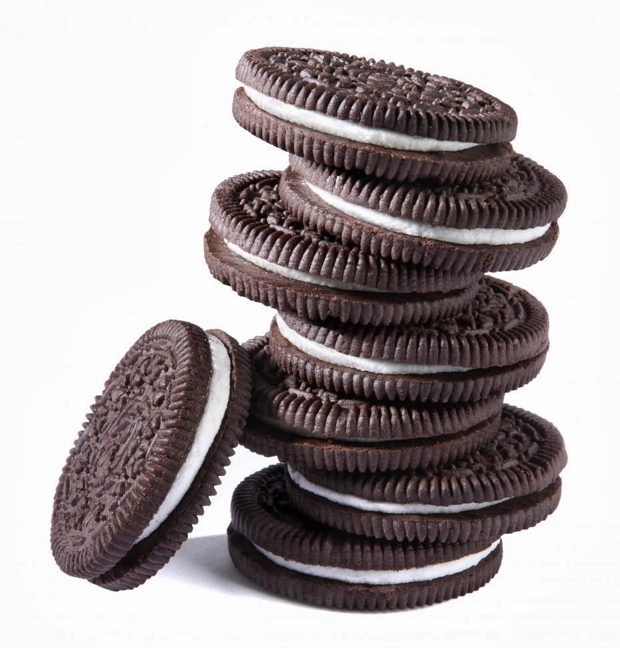
Cookie Method Weave Method
Excellent way of learning evaluation techniques
Commonly uses by experienced evaluators as it gives you more flexibility to bounce back and forth

Slide 5
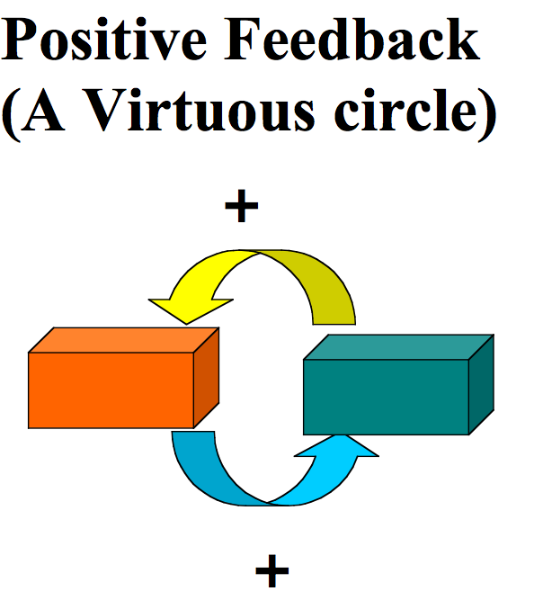
E
S
P
ncouraging
upportive
ositive

Slide 6
Encouraging
* Always make your comments encouraging, with the emphasis on the strong points
* Compliment what you felt were the good
points of the speech…without repeating the speech!
* Leave the speaker feeling good about the job they did delivering the speech.

Slide 7
Supportive
* Evaluate to the level of the speaker!
Don’t evaluate an Ice Breaker as you would an experienced speaker
*Use supportive words when giving feedback,
“I suggest”, “Perhaps saying it this way”,
“You might want to try”
*Refrain from using discouraging or negative words like; bad, poor or wrong

Slide 8
Positive
* Make your remarks complimentary, positive and reassuring
*When pointing out areas of improvement, do so in a kind gentle manner
*Let the speaker know they did a good job and you are eager to hear them speak again

Slide 9
6 Tips for an Evaluation
Meet with the speaker prior to the presentation
Find out the objectives of the project
Ask the speaker if there is anything in particular they want you to focus on during the speech
Evaluate to the level of the speaker
5. Never whitewash an evaluation
6. Be kind, be truthful and be encouraging

Slide 10
E
S
P
ncouraging
upportive
ositive

