Slide 1
Hybrid Meetings
Guide to Setting Up and Running a Hybrid Toastmasters Meeting
District 5 TLI, July 24, 2021
Alice Gander, EC4, VP Education
Gem City Toastmasters, Quincy, IL
District 8, Division C, Area 1

Slide 2
Background / Experience
COVID-19 pandemic restricted meetings in Illinois April/May 2020 and Dec 2020/Jan 2021
June 2020 Gem City Toastmasters began hybrid meetings
Now our standard approach for all meetings
What is your club doing? – Show of hands
What are your questions? – Type in Chat

Slide 3
What and Why
What is a Hybrid Meeting?
Attendance is both in person and virtual
Attendees choose the method most convenient and comfortable for their needs
What are the Benefits?
Retains in-person meetings for most members
Accommodates the needs of all members
Pandemic
Travel / vacation
Inclement weather
Any situation that prevents in-person attendance
Prospective members can check it out before coming

Slide 4
Establish two-way audio/video
Online attendees need to see and hear the lectern in the room and the overall meeting room.
People in the physical meeting room need to see and hear everyone who is attending online.

Slide 5
Online attendee experience
In-person Zoom master, video off
Lectern camera
Zoom attendees
Meeting Room camera

Slide 6
Meeting Room Setup
Projector and screen allow people in the room to see online attendees.
Tables are spaced apart for social distancing if desired or required.

Slide 7
Meeting Room Setup
Tables back to normal U-Shaped setup.
Projector allows people in the room to see the Zoom screen.

Slide 8
Physical Meeting Room Needs
WiFi Internet Access
Zoom or other web conferencing account
Laptop or computer attached to
Webcam to capture lectern speaker view
Microphone to capture the speaker and people in the room
Speakers to output sound from the online attendees
Projector and screen to see online attendees
Second camera/device pointed at the overall room
Zoom-master to set up and run technology

Slide 9
Technology Setup
Second device provides view of room
Lectern camera
Laptop drives
Lectern Camera
Speakers
Microphone
Projector

Slide 10
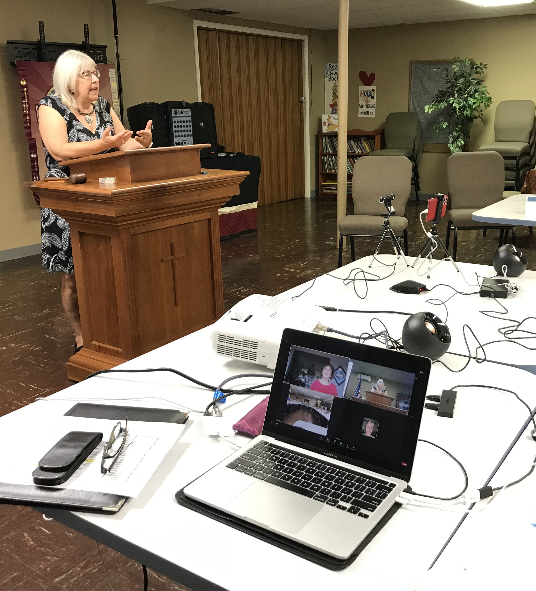
Technology Setup
Second device pointed at room
Lectern camera
Laptop drives
Lectern Camera
Speakers
Microphone
Projector

Slide 11
Tips and Tricks
Name the Zoom device pointed at the lectern “Lectern Camera”
Name the second device pointed at the room “Meeting Room”
A separate microphone is helpful if the mic in the webcam isn’t powerful enough for online attendees to hear the people in the physical room
Be sure only the laptop has audio on. All other devices in the room must disconnect audio.

Slide 12
More Tips and Tricks
Use Chat to send Word of the Day to online attendees
Turn off all mail and messaging apps on the laptop so they don’t popup during the meeting
Make sure lectern camera is pointed at the speaker if they move around and switch Zoom to speaker view as needed if someone is filling a role online

Slide 13
Challenges
Speakers in the room may walk out of camera view
Handouts / agendas need to be sent to all before the meeting or easily shared in Chat
If the Timer and Speaker are not both online or both in the room, a backup method is needed so the speaker can see the signals

Slide 14
Resources and Contact
District 8 hybrid meeting training 11/18/2020 https://www.youtube.com/watch?v=J8lD1uBttmA
https://dist8tm.org/wp-content/uploads/2020/11/Set-up-a-Hybrid-Toastmasters-Zoom-Meeting.pdf
Alice Gander, alice@alicegander.com

Slide 15
Equipment Used by Gem City
Better microphone bought to capture speakers in room for online attendees
Lectern camera so online can see speaker. Microphone is not good to hear whole room and is not used.
PC speakers to hear online attendees in room

Slide 16
Discussion and sharing experience

