Slide 1
The Chief Judge
Everything you ever wanted to know!
And more…
By Lucy Boyd-Wilson

Slide 2
Overview
Roles - assigned by the Chief Judge
Briefing Sessions - Judges, Timers, Counters
Forms and documents – so many!
Responsibilities - before, during and after the Contest
Staying organized!

Slide 3
Appoint Functionary Roles
Judges, Timers & Ballot Counters:
Minimum of 5 Voting Judges for Club and Area contests.
Minimum of 7 Voting Judges for higher levels.
A Tie-Breaking Judge
2 Timers
2 Ballot Counters

Slide 4
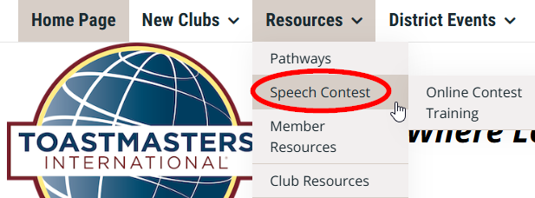
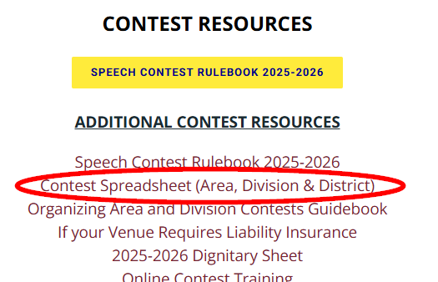
About Staying Organized…
Get the excel sheet from District 5 website!

Slide 5
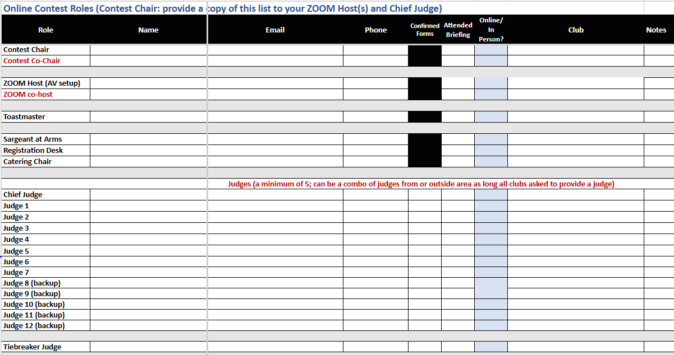

Slide 6
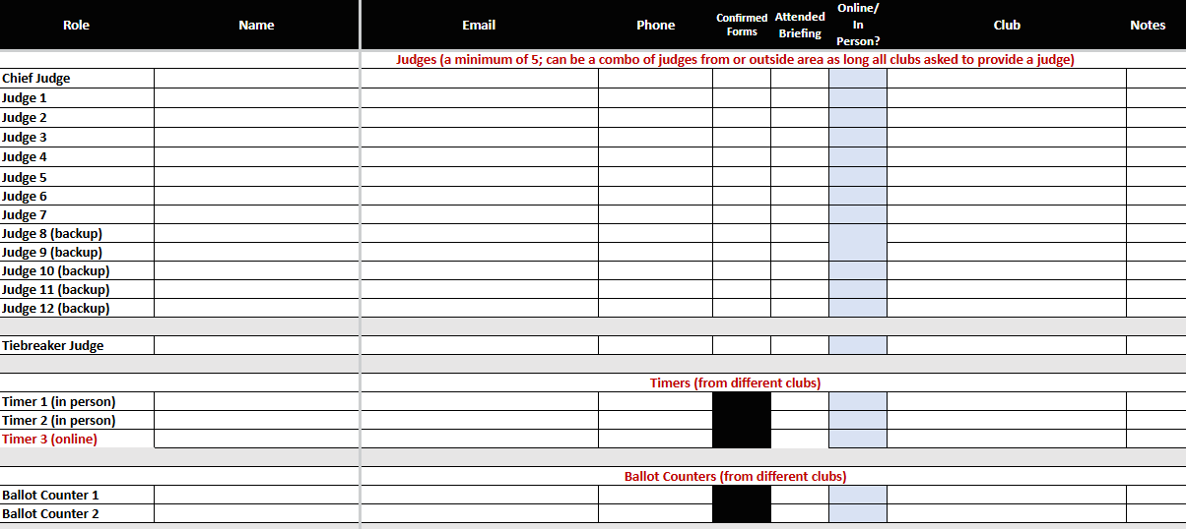

Slide 7
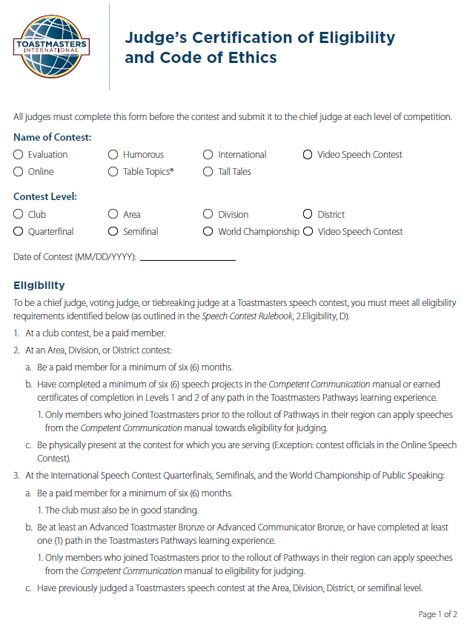
Judge’s
Certification of Eligibility
and Code of Ethics
Page 1 = Eligibility

Slide 8

Judge’s Eligibility
Club contest: Paid member.
Area, Division, or District contest:
Paid member for at least 6 months.
Completed Levels 1 and 2 in any Pathway.
Or 6 speeches in the Competent Communication manual.
ONLY for members who joined before Pathways.
Physical presence required for in-person contests.

Slide 9
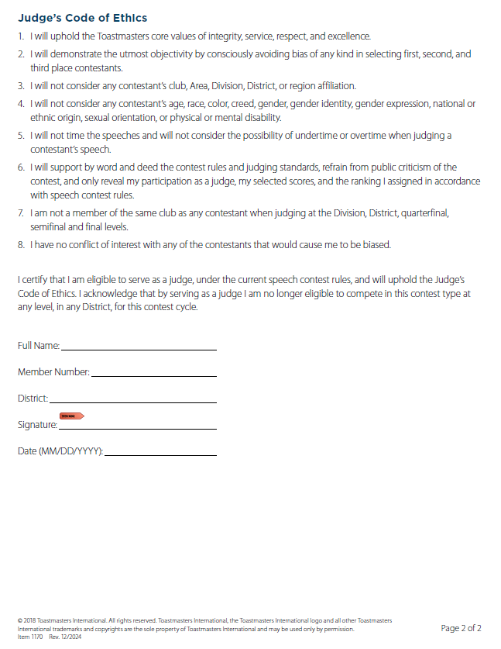
Judge’s
Certification of Eligibility
and Code of Ethics
Page 2 = Code of Ethics
Judges Sign the form.
Return to the Chief Judge.

Slide 10
Chief Judge’s Briefing Sessions
Judges’ Briefing
Timers’ Briefing
Counters’ Briefing

Slide 11
Judges’ Briefing
Anonymity - Judges do not reveal identity.
Tie-breaking Judge is secret and briefed separately.
How to fill out, sign, and submit the ballots.
Review the judging criteria.
Review the process for raising a protest.
Review the contestants speaking area.

Slide 12
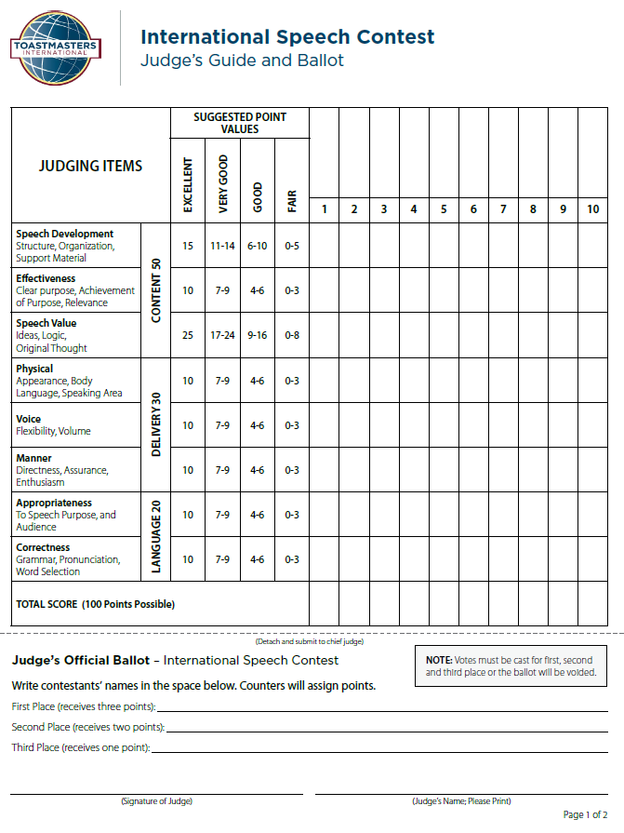
Judge’s Guide & Ballot
Scoring Section
The Ballot
Print Name & Sign!

Slide 13
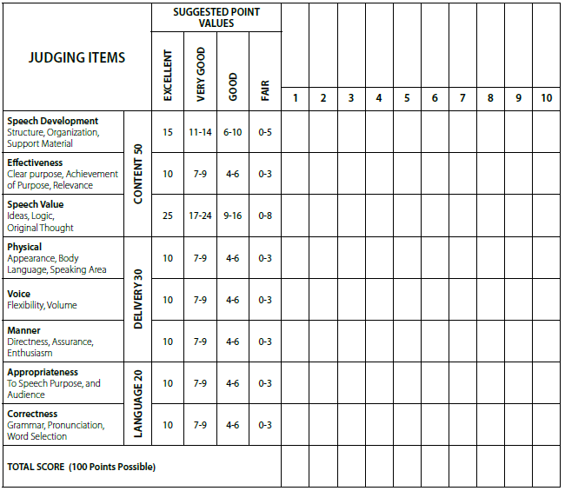
International Judges Guide
& Ballot
Julia
Miguel
Bob
Lee
Kate
8
9
15
Review:
Judging Criteria
Scoring
9
6
9
3
6
65

Slide 14
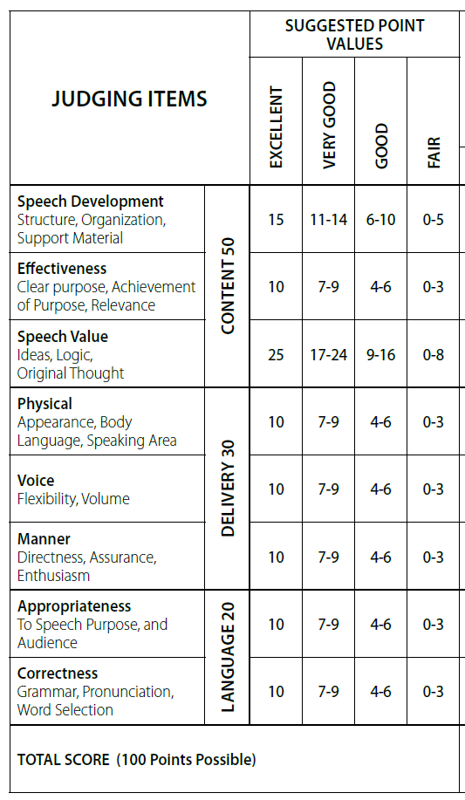
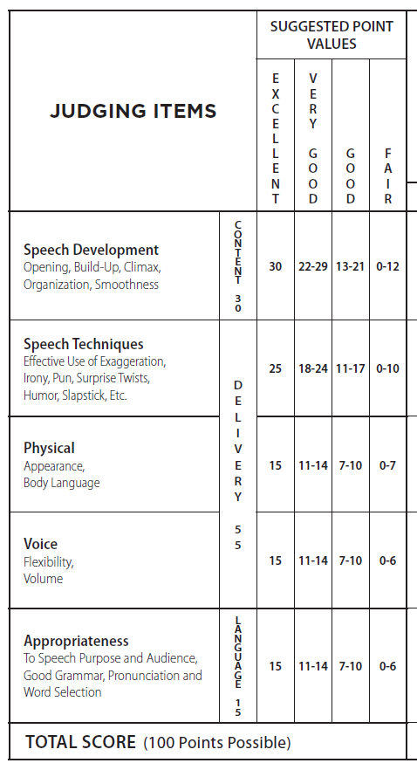
International
Tall Tales
International
vs.
Tall Tales
Scoring

Slide 15
Judges Guide & Ballot
Take the scoring portion home to dispose!
Tear here
Did you Print & Sign your Name?

Slide 16
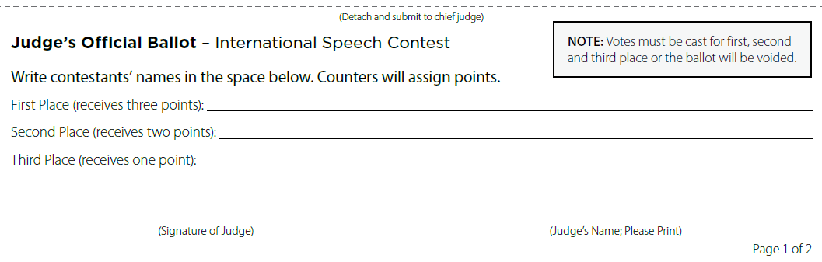
Judge’s Ballot
Enter 1st , 2nd, 3rd place contestant names.
No Ties!
Discretely hand ballot to Ballot Counters.

Slide 17
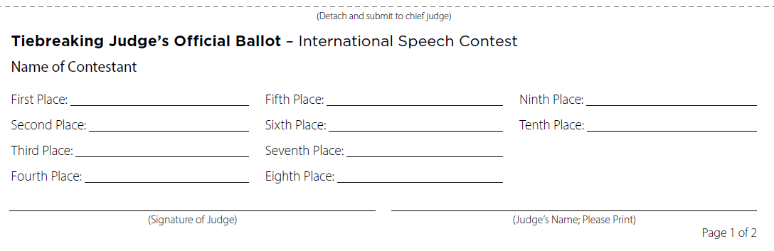
Tiebreaking Judge’s Ballot
Tiebreaking Judge ranks ALL the contestants.
No Ties!
Hands ballot to Chief Judge.

Slide 18
Timers’ Briefing
Review the timing procedure, including when to start and stop the timer.
Explain the signaling devices (lights, cards, flags).
Review the Time Record Sheet.
Timer submits Time Sheet to the Chief Judge.
Disqualifications are handled by the Chief Judge based on the timing record.

Slide 19
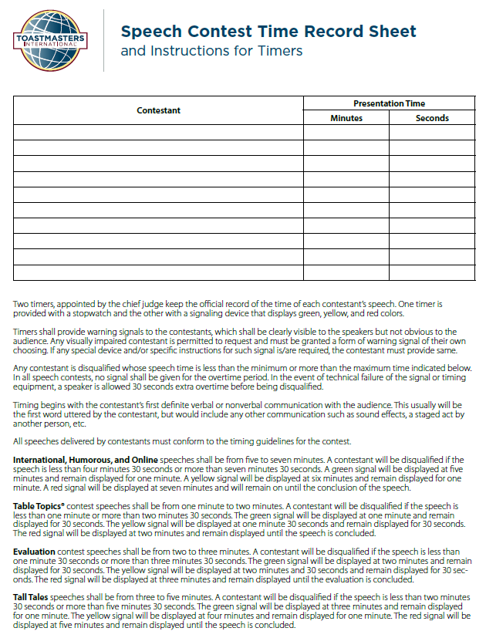
Timers’ Briefing
2 Timers
One with stopwatch
Other with signaling device
International – 5 to 7 minutes
Show lights at 5, 6, 7 minutes
Tall Tales – 3 to 5 minutes
Show lights at 3, 4, 5 minutes

Slide 20
Ballot Counters’ Briefing
Discreetly collect ballots from judges.
Review the Counter's Tally Sheet to tally the results.
How to resolve discrepancies in the scoring.
Unsigned judges ballot – disqualifies the ballot!
How to resolve a tie using the Tiebreaking ballot.
And more…

Slide 21
The Contest or Two!
Contest #1 - Tall Tales
Contestants speak
Judges score each speaker
After the speeches, judges complete their ballots.
Counters collect the ballots from voting judges.
Chief Judge collects the Tiebreaking ballot and Time Record sheet.
Chief Judge and Counters withdraw to tally the ballots.

Slide 22
Check Timer’s Report
International Contest
5 to 7 minutes
Disqualified if less than 4:30 or more than 7:30 mins
Tall Tales
3 to 5 minutes
Disqualified if less than 2:30 or more than 5:30 mins

Slide 23
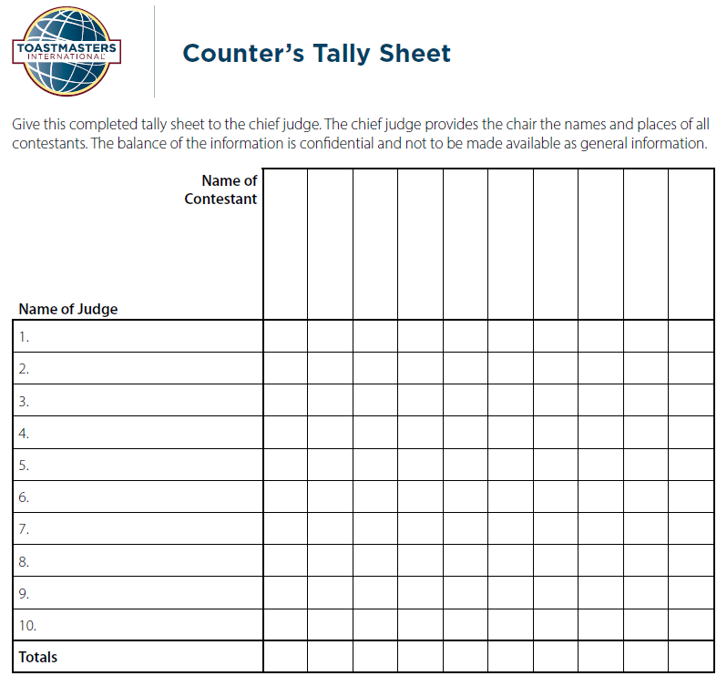
Counter’s
Tally Sheet
3 points for 1st place
2 points for 2nd place
1 point for 3rd place
If a tie results, refer to the Tiebreaking ballot.
Miguel
Lee
Julia
Bob
Kate
Alan
1
3
2
Bella
2
1
3
Zoe
2
1
3
Ramiro
1
2
3
Mike
1
2
3
4
4
6
10
6

Slide 24
Tiebreaking Judge’s Ballot
Resolve tie between Miguel & Lee
Resolve tie between Julia & Bob
Miguel
Kate
Julia
Lee
Bob

Slide 25
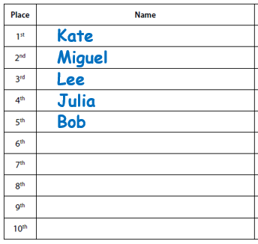
Final Full Ranking
Chief Judge takes note of the final FULL Ranking.

Slide 26
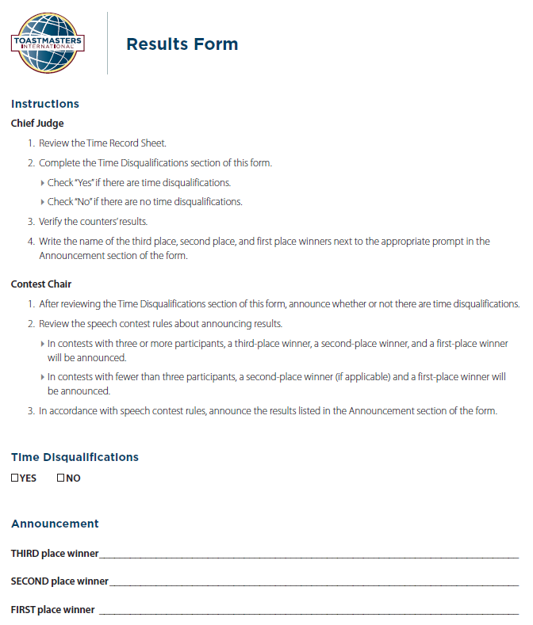
Results Form
Filled out by Chief Judge
Yes/No Time Disqualifications
3rd, 2nd, 1st Place Winners
Reverse Order!

Slide 27

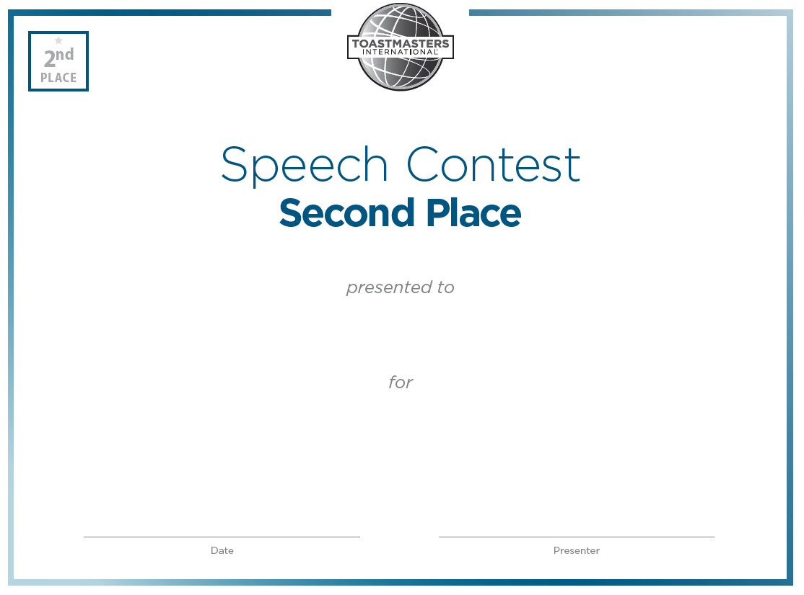
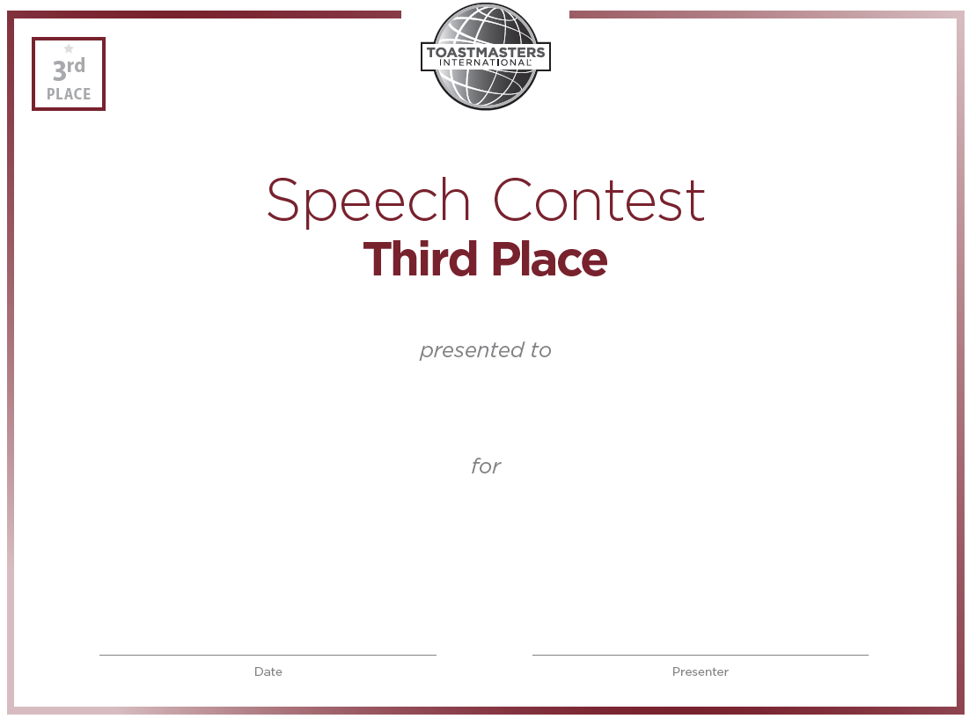
Fill out the Winner Certificates

Slide 28
Fill out the Winner Certificates
Practice your
hand-writing ☺
Kate Jones
Tall Tales Speech Contest - Area 99, District 5
Print in advance
December 6th, 2025
Michel Dubois

Slide 29
Return to Contest Room
Signal to Contest Toastmaster that the Results are ready.
Give to Results Form and Certificates to Chair/Toastmaster.

Slide 30
Back to the Contest
Contest #2 - International
Contestants speak.
Judges fill out the ballots.
Ballots and Time Sheet are collected.
Chief Judge and Counters withdraw to tally the ballots.
Second time!
Winners are Announced!

Slide 31
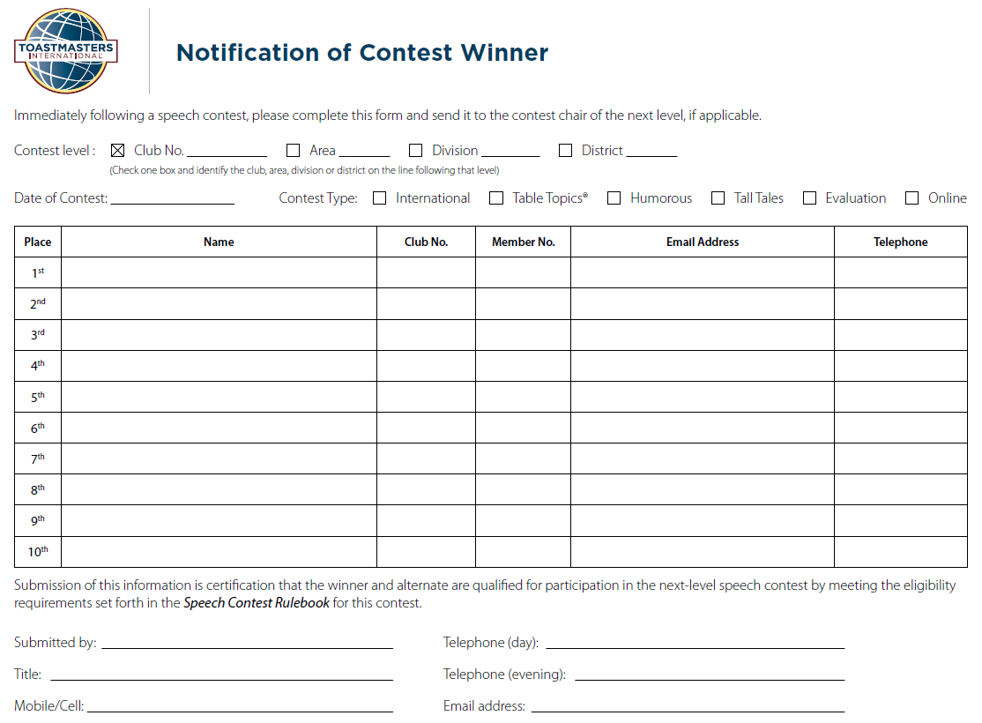
After the Contest
Chief Judge completes this form.
Returns it to Contest Chair of the next level up.
Kate
Miguel
Lee
Julia
Bob

Slide 32

Questions?
Chief Judge’s Checklist in the Rule Book
District 5 Contest Resources page:
Spreadsheet
Guide Book by Mark Kramer
Toastmasters Speech Contest Team:
Email: speechcontests@toastmasters.org
Tel: 720-439-5050

Slide 33
Congratulate Your Team
On a Job Well Done!
🌟

